Slide 1
Eval services top 10 faq

Slide 2
1. Can a sick student log back into their test?
If a student goes home sick*, they are allowed to log back in upon return to complete their assessment
As long as the student logs back in within 2 calendar days, no action needs to be taken in TIDE
After 2 calendar days, you will need to submit a “Reopen Test” request in TIDE
Make sure that you email Nate and Heather that you have created this request in TIDE – we do not receive notifications

Slide 3
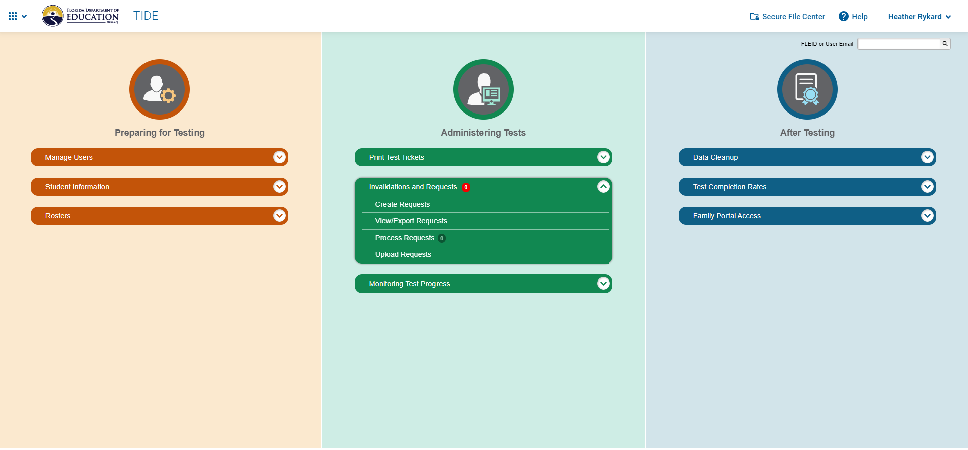

Slide 4
Session ID
Results ID
FLEID

Slide 5
2. Can I delete students from TIDE?
NO
YES
Student went to another school in the district – email Heather/Nate to move transfer the student in TIDE
Student is marked for FAA – call Karen Robinson (there are 2 sides of TIDE)
Student moved – wait until you have proof of enrollment (see “Yes” column)
You have received a records request from an out of state or out of district school

Slide 6
3. My K-2 student had a bad test day – can I deactivate their test?
Short answer…No
You may, however, test them again during the test window or outside the window to get another measure of his/her/their performance
State and district uses the first test taken in an active testing window

Slide 7
4. Student information in TIDE won’t save
If you are manually adding or updating a student’s demographic information, you must ensure that all required information is selected
This includes Test Eligibility
Must select “Eligible for Computer Based Assessment” or eligible accommodated, if applicable
Make sure you are selecting ALL assessments that a student will take

Slide 8
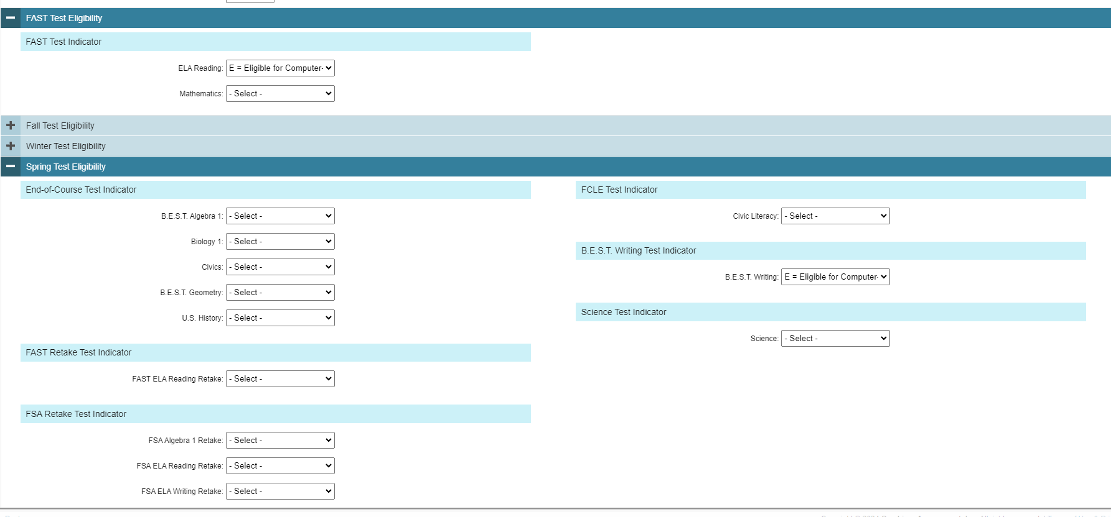
Grades 3-10
Grades 3-8 (not in Alg/Geom)
Eligible Course
Currently enrolled
Grades 4-10
Grades 5 & 8
Eligible retakers ONLY
Eligible retakers ONLY

Slide 9
5. I have a new student that isn’t showing up in TIDE
Are they from another Florida district or out of state?
Are they from another Escambia County School?
Email Heather and/or Nate
We will transfer them for you in TIDE
DO NOT make a new entry for these students
Once they have an FLEID populate into FOCUS (in the Classified tab), you can manually enter them into TIDE
Make sure you are entering the Student ID into the “District Use” field
Correctly add any IEP or 504 accommodations, if necessary

Slide 10
6. I have a new teacher/staff who needs an account in TIDE
You can add user accounts for Test Administrator, AVA Test Administrator, and School Reporting Access from your role as School Assessment Coordinator.
If you need a user account added for School Administrator, School Assessment Coordinator, or School Data Entry, please email Heather and/or Nate with your request.
If your principal is requesting additional personnel to have the School Assessment Coordinator role to assist with testing, please have them email Nate.

Slide 11
7. I have a teacher who can’t see a student’s scores from PM1/2/3
Double check that the student has a submitted/completed test for the PM period in question
Pull up the student in TIDE and look at the “Student Participation” section
Make sure the student is correctly rostered* to the teacher
Make sure you have your FRS dashboard set up to pull the correct PM data or subject that you are looking for
*If the student is not on the teacher’s roster, or if the teacher changed, you will need to edit the roster
Call Charlie Henderson in Eval Services 850-469-5308 if you hit a snag!
* See Question 8

Slide 12
List of active rosters/teachers who can view scores
Where you verify if a PM test was actually taken/submitted

Slide 13
8. I have missing students on a teacher’s roster
You can search for missing students by using the “View/Edit/Roster” rosters tile on the TIDE Dashboard
If the student was re-enrolled after moving, you may have to select the “Former Students” button in the “Show More Information” dropdown inside the roster

Slide 14
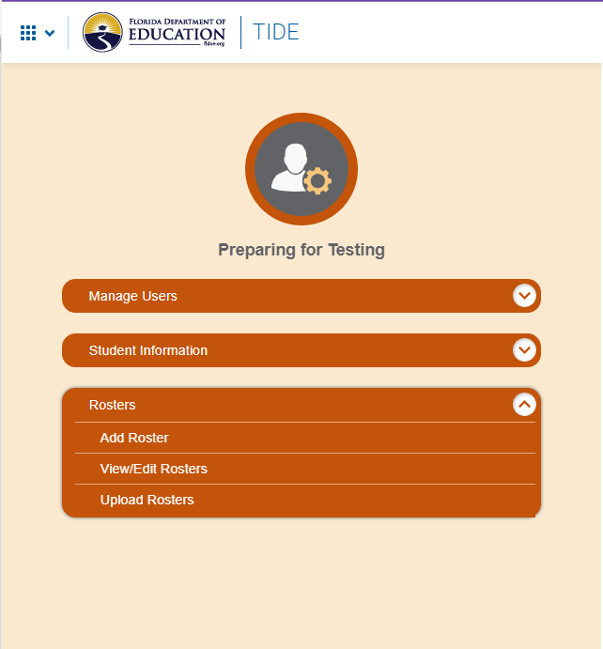

Slide 15
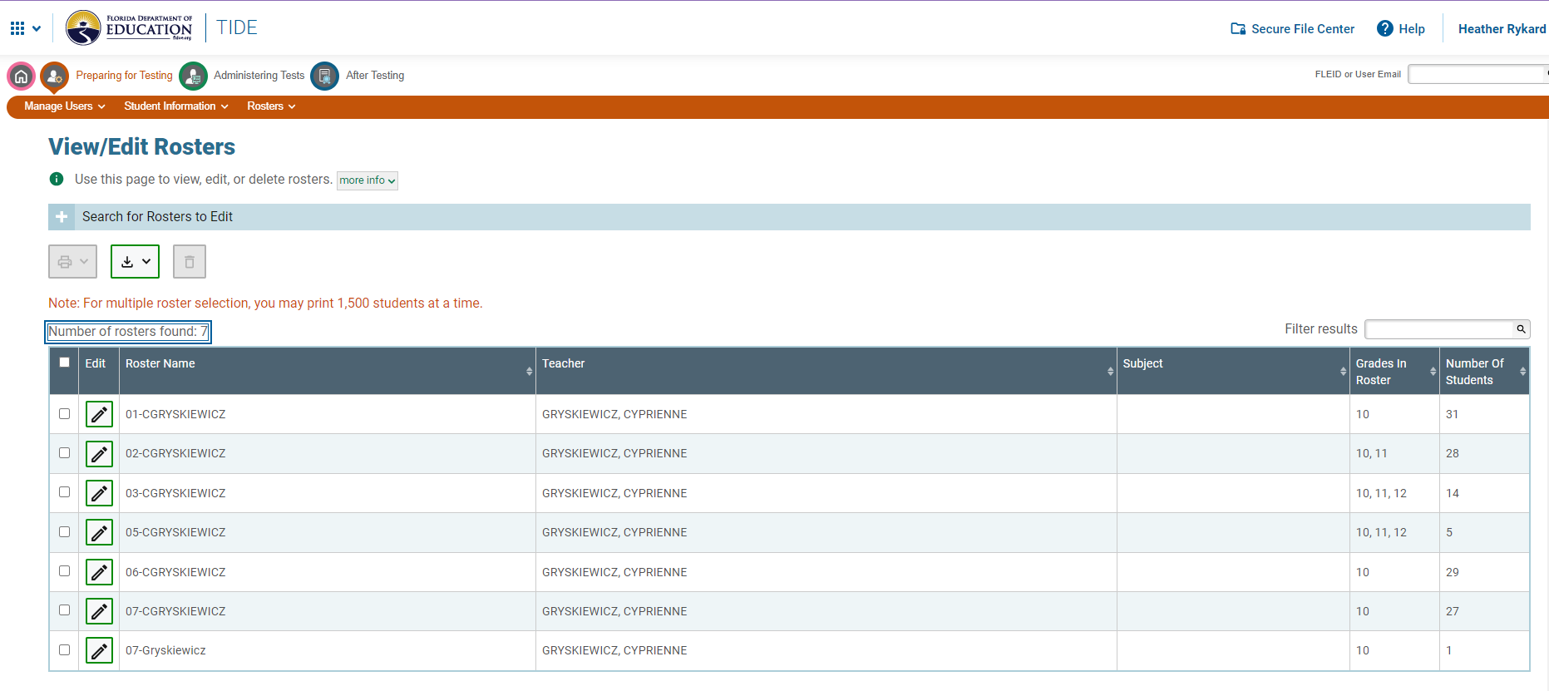

Slide 16
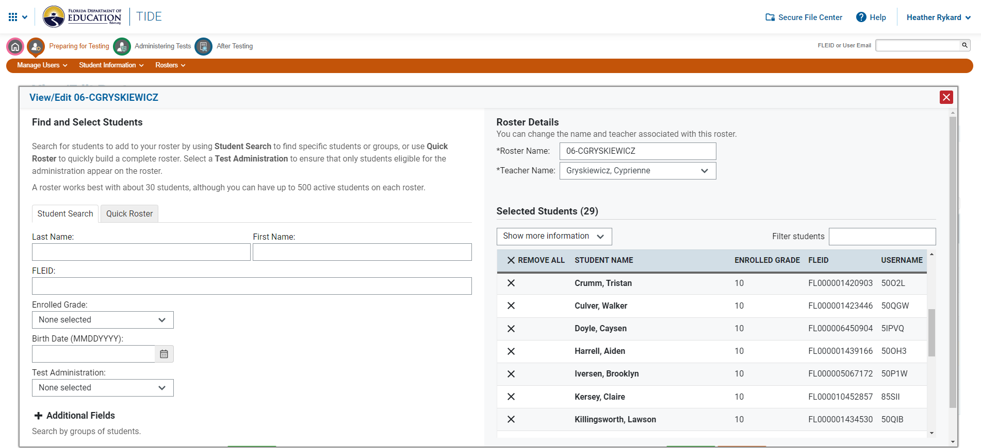
Type a student’s name to search and add

Slide 17
9. Where can I find manuals/scripts/user guides?
Evaluation Services webpage – we have links for grade-specific materials (K-2, 3-10)
Google classroom by level – Elementary or Secondary…
Contact Heather for access
State’s testing site – www.FlFast.org
There is now a one-stop shop for all things test administration related
Testing Resources for Grades K-2
Testing Resources for Grades 3-10
Don’t forget about the TA Certification Course!

Slide 18
Grades K-2
https://flfast.org/testing-resources-K2-teacher.html
Renaissance Support Team number
Dates
Guides
Manuals
Accommodations info
Sample test items

Slide 19
Grades 3-10
https://flfast.org/test-admin-resources.html
Manuals
Scripts
User Guides
Forms & Signs
Student Materials

Slide 20
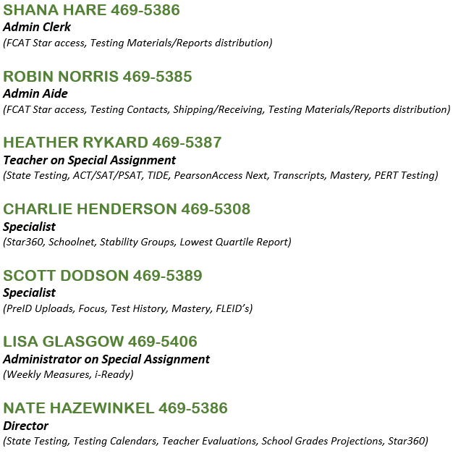
10. What if I don’t know who to call for help?

